Slide 1
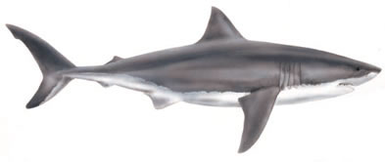
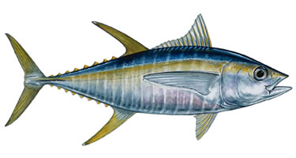
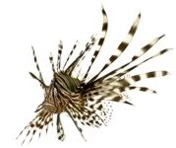
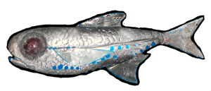
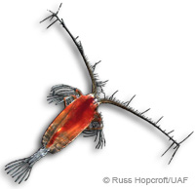
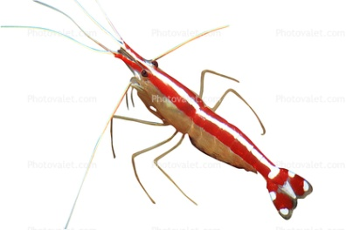
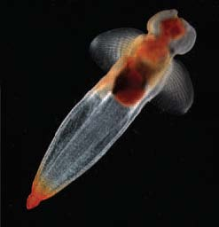
Made by Verity
Marine Food Web
5th Order Consumers
Large Sharks
4th Order Consumers
Small Sharks and Tuna
3rd Order Consumers
Squids and Lion Fish
2nd Order Consumers
Lantern Fish, Amphipods and Sun Fish
1st Order Consumers
Cleaner Shrimps, Copepods and Pteropods
Producers
Dinoflagellates and Diatoms (Plankton/Algae)
Energy From
The Sun

